Slide 1
Robot visualization area
Visualization of the working area of a kuka arm-robot

Slide 2
Content
Introduction
Models
Animation
Voxel World
Visualization and Prediction
Question

Slide 3
Introduction
Motivation
Part of a bigger project which intends on to develop this as AR with real robot
How can we predict movements?
Creating a virtual environment for a robot
Notes:
Environment, including animation

Slide 4
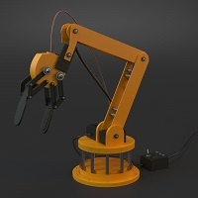
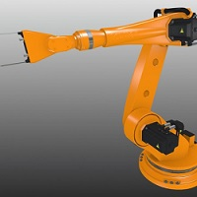
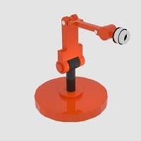
Models
Notes:
Open source
Rigged (skeleton)
Blender changes

Slide 5
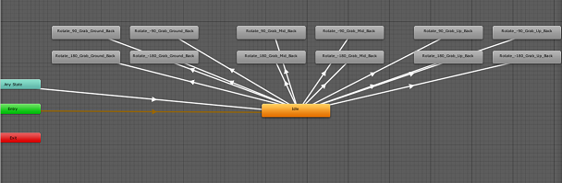
Animation
A set of 12 different animations
Play one or create a sequence of multiple animations
Played randomly based on one trigger
Notes:
State machine

Slide 6
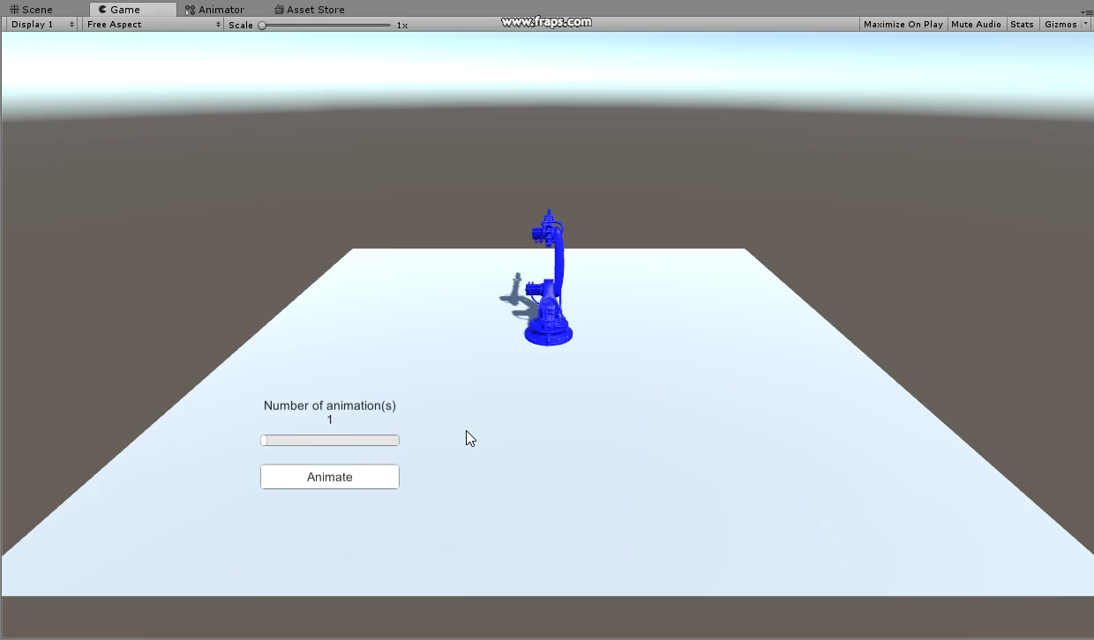
Animation

Slide 7
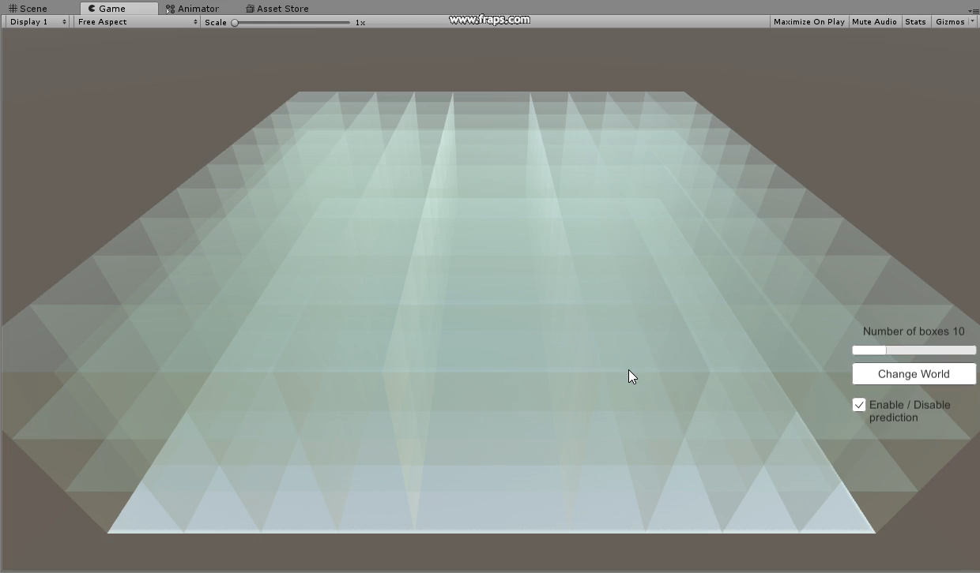
Voxel World
Notes:
Voxel is the 3d representation of a pixel
Little box on the plan you saw earlier

Slide 8
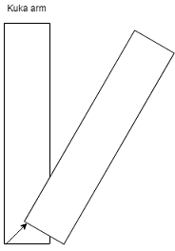
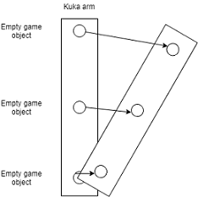
Visualization and Prediction
Vector based
Upgrading of Kuka model
Collision detector with Raycast and colliders
Cleaning

Slide 9
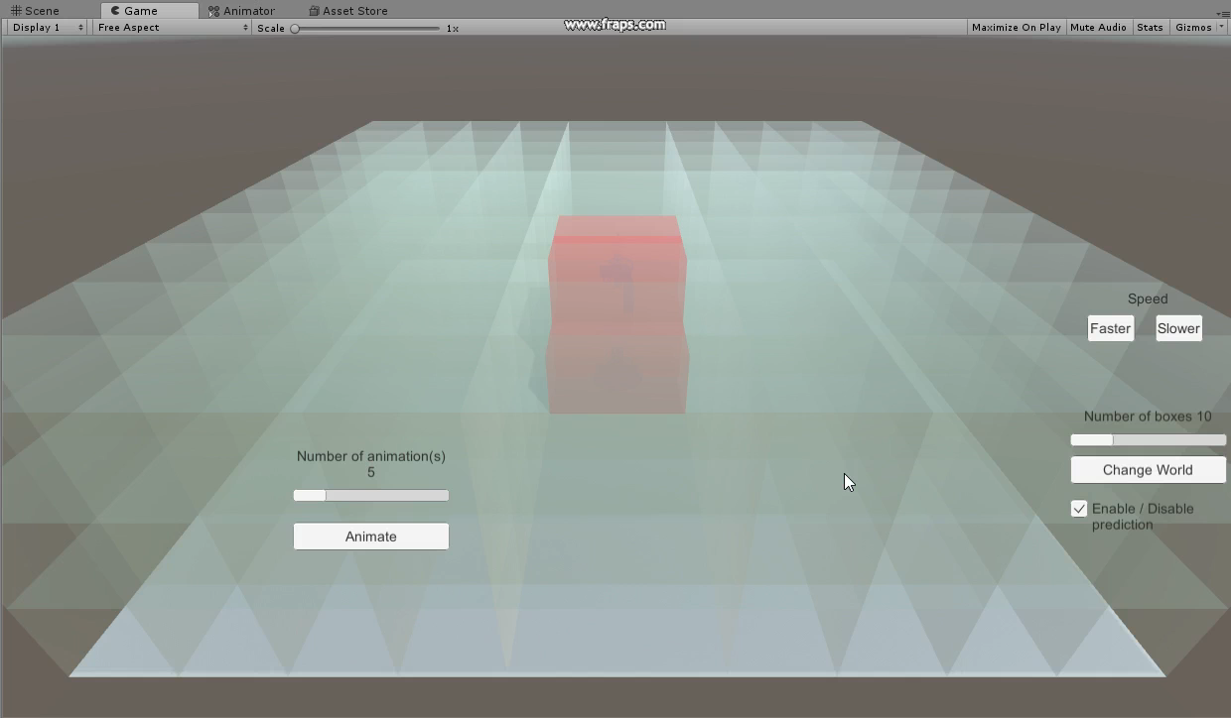
Visualization and Prediction

Slide 10
Question(s) ?

